Slide 1


NotFake.exe
SCTR’S PUNE INSTITUTE OF COMPUTER TECHNOLOGY
TECHFIESTA’26
INTERNATIONAL HACKATHON
CODE. CREATE. CONQUER
TITLE PAGE
Problem Statement ID: FD003
Problem Statement Title: Fake Transaction Detector - Spot The Anomaly!
PS Domain: Fintech
Team ID:
Team Name: NotFake.exe

Slide 2
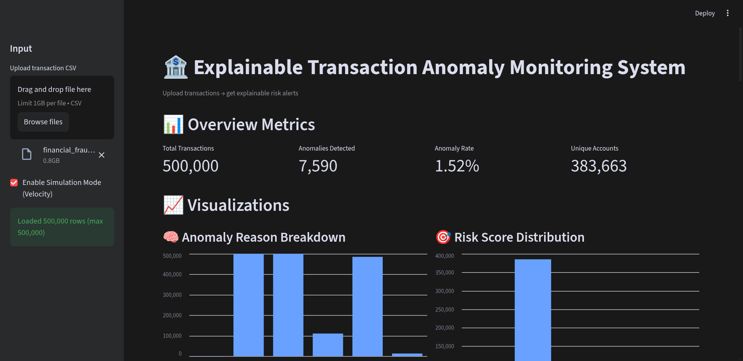



IDEA TITLE
An explainable, rule-based system that detects suspicious transactions and clearly explains every decision.
INPUT
Signal Extraction
Risk Logic
OUTPUT
Transaction Data (Amount, Time, Device, Location)
Behavioural & Context Signals (Amount deviation, device, time)
Transparent Rule-Based Risk Scoring
Flagged Transactions
“Clear Reasons”
Core Idea
Monitor transactions using multiple simple risk signals
No black-box ML or hidden logic
Designed for low-history users
Decision Logic
Each risk signal adds one risk point
Multiple weak signals → strong alert
Two-step confirmation to reduce false positives
Explainable Decisions
Fully explainable & audit-friendly
Works offline without servers
Easy to extend with ML later

Slide 3






TECHNICAL APPROACH
Data Ingestion
1
Load transaction data (CSV / offline dataset)
No dependency on live servers
Context Building
Logic Summary
2
Build minimal user context from available history
Handle first-time users safely
Decision Model
Rule-based
Fully explainable
Deterministic output
Signal Extraction
3
Amount deviation
Device & IP novelty
Location change
Time-of-day behavior
Velocity (simulation mode)
Execution Mode
Offline-capable
Batch or simulated real-time
Risk Aggregation
4
Convert signals into binary risk flags
Additive risk scoring (no weights, no ML)
System Output
Decision Confirmation
Risk score
Anomaly flag
Human-readable reasons
5
Second-layer behavioural check
Reduce false positives
Final anomaly decision

Slide 4
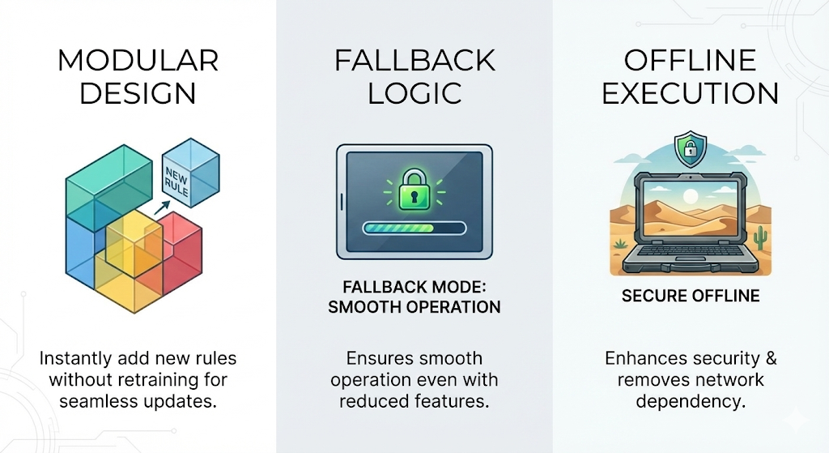
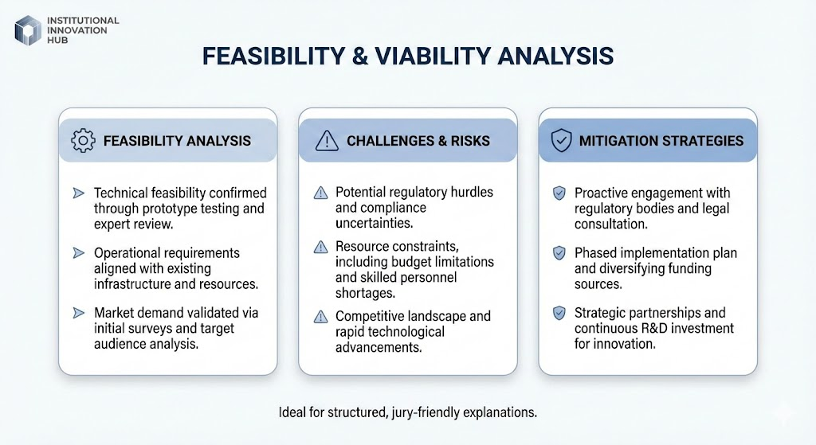
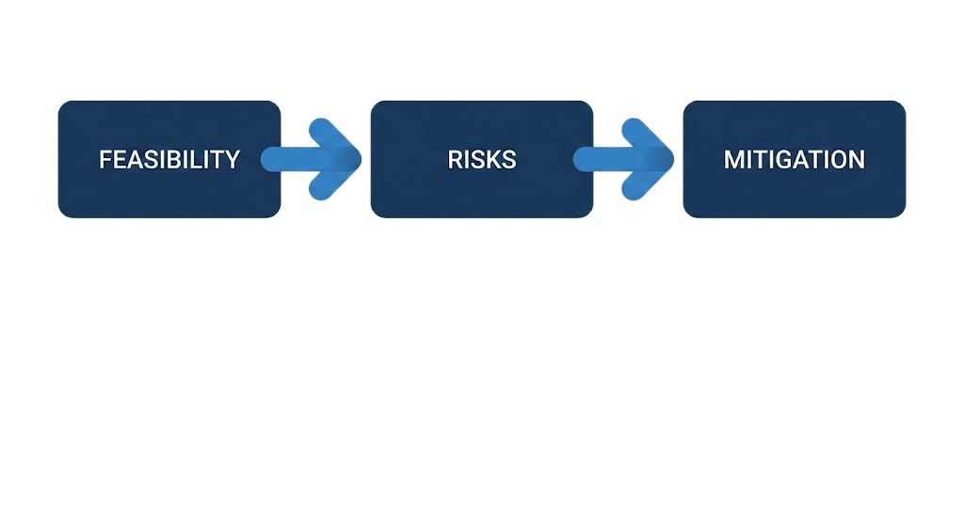
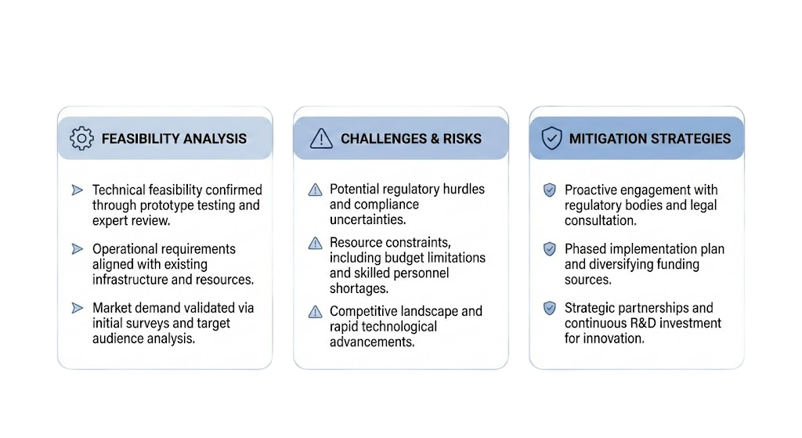
FEASIBILITY AND VIABILITY
A lightweight, explainable, offline-capable anomaly detection engine designed for real banking environments
The system is built on a lightweight mathematical rule-engine rather than a heavy ML model, making it extremely fast, stable, and easy to run on any machine.
Our engine processes large datasets (5 lakh+ rows) in under 30–35 seconds, even without servers or GPUs.
No retraining is required. If features increase or decrease, the engine adjusts automatically without breaking the workflow.
Works fully offline, which aligns well with real financial environments where data cannot leave secure systems.
Missing or incomplete features do not affect output — the system recalculates risk using available information.
Banking data may have missing or inconsistent fields, affecting reliability.
As datasets grow, maintaining consistent processing speed is essential.
Rule-based models need occasional updates to track evolving fraud patterns.
Threshold tuning is critical to avoid false positives or missed anomalies.
Modular design allows new rules to be added instantly, without retraining
Built-in fallback logic ensures smooth operation even with fewer features.
Offline execution enhances security and removes network dependency.

Slide 5
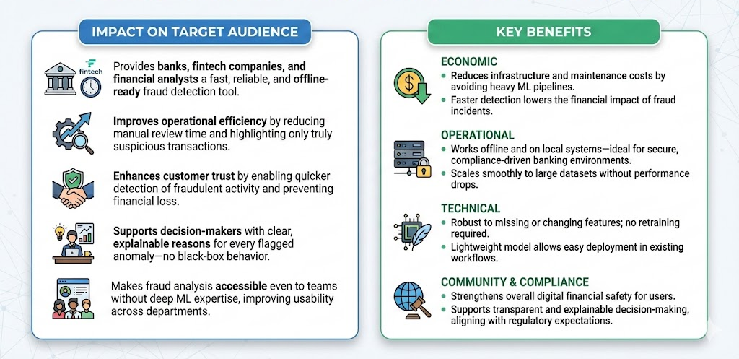
IMPACT AND BENEFITS

Slide 6
RESEARCH AND REFERENCES
Details / Links of the reference and research work

